Slide 1
ECE 3364 Circuits and Systems
Lecture Set #3
Mutual Inductance
Version 6
Dr. Dave Shattuck
Associate Professor, ECE Dept.
Shattuck@uh.edu
713 743-4422
W326-D3
Shattuck@uh.edu
713 743-4422
W326-D3

Slide 2
Overview of Lecture Set Mutual Inductance
In this lecture set, we will cover the following topics:
Define what we mean by mutual and self inductance.
Introduce the dot convention for assigning voltage reference polarities.
Consider the energy stored in coupled coils.

Slide 3
Copyright Notice
This work is protected by United States copyright laws and is provided solely for the use of instructors in teaching their courses and assessing student learning. Dissemination or sale of any part of this work (including on the World Wide Web) will destroy the integrity of the work and is not permitted. The work and materials from it should never be made available to students except by instructors using the accompanying text in their classes. All recipients of this work are expected to abide by these restrictions and to honor the intended pedagogical purposes and the needs of other instructors who rely on these materials.

Slide 4
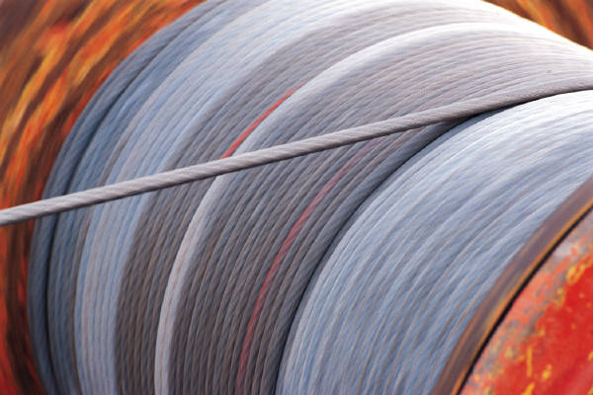
Inductor Review
An inductor is a two terminal circuit element that has a voltage across its terminals which is proportional to the derivative of the current through its terminals.
The coefficient of this proportionality is the defining characteristic of an inductor.
An inductor is the device that we use to model the effect of magnetic fields on circuit variables. The energy stored in magnetic fields has effects on voltage and current. We use the inductor component to model these effects.
In many cases a coil of wire can be modeled as an inductor.

Slide 5
Inductors – Definition and Units
An inductor obeys the expression
where v_{L} is the voltage across the inductor, and i_{L} is the current through the inductor, and L_{X} is called the inductance.
In addition, it works both ways. If something obeys this expression, we can think of it, and model it, as an inductor.
The unit ([Henry] or [H]) is named for Joseph Henry, and is equal to a [Volt-second/Ampere].
There is an inductance whenever we have magnetic fields produced, and there are magnetic fields whenever current flows. However, this inductance is often negligible except when we wind wires in coils to concentrate the effects.

Slide 6
Schematic Symbol for Inductors
The schematic symbol that we use for inductors is shown here.
This is intended to indicate that the schematic symbol can be labeled either with a variable, like L_{X}, or a value, with some number, and units. An example might be 390[mH]. It could also be labeled with both.

Slide 7
Inductor Polarities
Previously, we have emphasized the important of reference polarities of current sources and voltages sources. There is no corresponding polarity to an inductor. You can flip it end-for-end, and it will behave the same way.
However, similar to a resistor, direction matters in one sense; we need to have defined the voltage and current in the passive sign relationship to use the defining equation the way we have it here.

Slide 8
Passive and Active Sign Relationship for Inductors
The sign of the equation that we use for inductors depends on whether we have used the passive sign relationship or the active sign relationship.
Passive Sign Relationship
Active Sign Relationship

Slide 9
Defining Equation, Integral Form, Derivation
The defining equation for the inductor,
can be rewritten in another way. If we want to express the current in terms of the voltage, we can integrate both sides. We get
We pick t₀ and t for limits of the integral, where t is time, and t₀ is an arbitrary time value, often zero. The inductance, L_{X}, is constant, and can be taken out of the integral. To avoid confusion, we introduce the dummy variable s in the integral. We get
We finish the derivation in the next slide.

Slide 10
Defining Equations for Inductors
We can take this equation and perform the integral on the right hand side. When we do this we get
Thus, we can solve for i_{L}(t), and we have two defining equations for the inductor,
and
Remember that both of these are defined for the passive sign relationship for i_{L} and v_{L}. If not, then we need a negative sign in these equations.

Slide 11
Note 1
The implications of these equations are significant. For example, if the current is not changing, then the voltage will be zero. This current could be a constant value, and large, and an inductor will have no voltage across it. This is counter-intuitive for many students. That is because they are thinking of actual coils, which have some finite resistance in their wires. For us, an ideal inductor has no resistance; it simply obeys the laws below.
We might model a coil with both inductors and resistors, but for now, all we need to note is what happens with these ideal elements.
and

Slide 12
Note 2
The implications of these equations are significant. Another implication is that we cannot change the current through an inductor instantaneously. If we were to make such a change, the derivative of current with respect to time would be infinity, and the voltage would have to be infinite. Since it is not possible to have an infinite voltage, it must be impossible to change the current through an inductor instantaneously.
and

Slide 13
Note 3
Some students are troubled by the introduction of the dummy variable s in the integral form of this equation, below. It is not really necessary to introduce a dummy variable. It really doesn’t matter what variable is integrated over, because when the limits are inserted, that variable goes away.
The independent variable t is in the limits of the integral. This is indicated by the i_{L}(t) on the left-hand side of the equation.
Remember, the integral here is not a function of s. It is a function of t.
This is a constant.
and

Slide 14
Energy in Inductors, Derivation
We can take the defining equation for the inductor, and use it to solve for the energy stored in the magnetic field associated with the inductor. First, we note that the power is voltage times current, as it has always been. So, we can write,
Now, we can multiply each side by dt, and integrate both sides to get
Note, that when we integrated, we needed limits. We know that when the current is zero, there is no magnetic field, and therefore there can be no energy in the magnetic field. That allowed us to use 0 for the lower limits. The upper limits came since we will have the energy stored, w_{L}, for a given value of current, i_{L}. The derivation continues on the next slide.

Slide 15
Energy in Inductors, Formula
We had the integral for the energy,
Now, we perform the integration. Note that L_{X} is a constant, independent of the current through the inductor, so we can take it out of the integral. We have
We simplify this, and get the formula for energy stored in the inductor,

Slide 16
Mutual Inductance
Inductors model the interaction between magnetic fields and voltage and current. However, the magnetic field from one coil can have an effect on another coil. Thus, one inductor can affect another inductor. This effect does not just occur; we can use it to produce desired results, most significantly, in transformers, covered in the next lecture set.
A transformer is two inductors, whose magnetic fields are joined by a magnetic core.

Slide 17
Mutual Inductance
We model this effect with what we call “mutual inductance”, and we call it M. We also rename L, as the “self inductance”.

Slide 18
Mutual Inductance
We model this effect with what we call “mutual inductance”, and we call it M. We also rename L, as the “self inductance”.
For our course, we will use the assumption that the influence of one coil on the other, is the same as the second on the first. That is,
M₁₂ = M₂₁ = M.

Slide 19
Mutual Inductance
We model this effect with what we call “mutual inductance”, and we call it M. We also rename L, as the “self inductance”.
The value of M is a function of the coupling of the flux,
The quantity k is defined as the “coefficient of coupling”, and

Slide 20
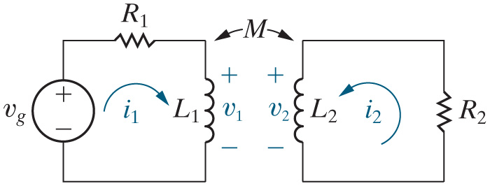
Mutual Inductance
We call
and
the self-inductances of the coils.
We call M the mutual inductance of the coils.
and
and M are related by the following equation:
k is called the coupling coefficient, and is a measure of how much of the magnetic field of one coil envelops the other coil.

Slide 21
Mutual Inductance
The polarity of the self-induced voltage for the two coils is determined by the passive sign relationship.
Based on the inductor voltage polarities and current directions shown in the circuit, the two self-induced voltage terms in the above equations are both positive.
The sign of the mutually-induced voltage for the two coils is determined by physical examination of the coils, and is notated on the circuit schematic using dots.
To determine the sign of the mutually-induced voltages for the two coils, use the dot convention.

Slide 22
Polarity of Mutually Induced Voltages (The Dot Convention)
Even here, we need to be able to get the signs of voltages and currents right. It is too cumbersome to show the directions of the windings in our schematics. Thus, they have introduced the dot convention, to make it easier to keep track of the polarity of mutually induced voltages.
We will not cover in this course how the winding directions are used to determine the dot markings.

Slide 23
The Dot Convention
The rule for using the dot markings:
When the reference direction for a current enters the dotted terminal of a coil, the reference polarity of the voltage induced in the other coil is positive at the dotted terminal.
We will redefine the dot convention for transformers later in this lecture set.

Slide 24
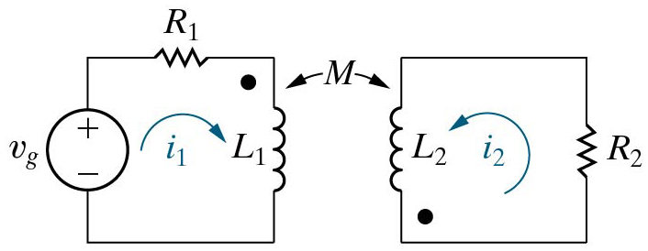
Dot Convention
The dot convention for mutually-coupled coils:
When the current enters the dotted terminal of one coil, the mutually-induced voltage drop is positive at the dotted terminal of the other coil.
When the current enters the un-dotted terminal of one coil, the mutually-induced voltage drop is positive at the un-dotted terminal of the other coil.

Slide 25
Writing KVL with the Dot Convention
Follow these steps to write KVL for each of the loops in a circuit.
Define the mesh currents.
Sum the voltage drops around the mesh, using the appropriate sign relationship for the self-induced voltage terms.
Consider the current in the other mesh. If it enters the dot, the mutually-induced voltage term is positive at the dot of the other coil.

Slide 26
Writing KVL with the Dot Convention
Follow these steps to write KVL for each of the loops in a circuit.
Define the mesh currents.
Sum the voltage drops around the mesh, using the appropriate sign relationship for the self-induced voltage terms.
Consider the current in the other mesh. If it enters the dot, the mutually-induced voltage term is positive at the dot of the other coil.
For the example given:

Slide 27
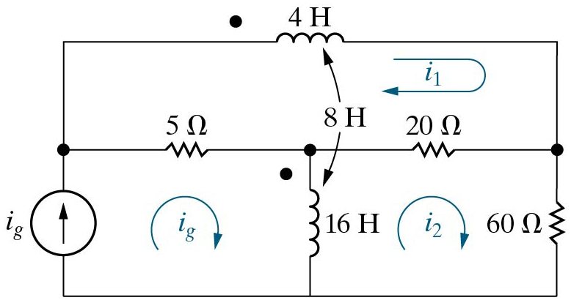
Example Problem
Use the mesh-current method to write equations for the circuit shown. This is Figure 6.29 from the Nilsson and Reidel textbook, 12th Ed. Note that for this circuit, this means writing two equations in the two unknowns, i₁ and i₂, since the third mesh current is clearly equal to the value of the current source, which is assumed to be known.

Slide 28
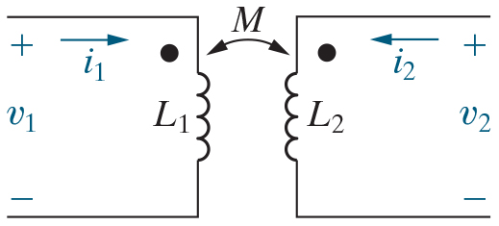
Total Energy Stored in Coupled Coils
Use the circuit here to calculate the total energy stored in magnetically coupled coils.
Initially, assume both currents and the stored energy are
zero. Then let
increase from 0 to
and calculate the stored
energy:

Slide 29
Total Energy Stored in Coupled Coils
Use the circuit here to calculate the total energy stored in magnetically coupled coils.
Now hold
at
and increase
to
during this increase, the voltage
induced in coil 2 by
is zero because
is constant. The voltage
induced in coil 1 by
is
so the power in the two coils is
The total energy when
reaches
is

Slide 30
Total Energy Stored in Coupled Coils
Note that in this example, both currents enter the dotted terminals. If one current enters a dotted terminal and the other current leaves, the algebraic sign of the term involving M reverses. Therefore, in general,

Slide 31
So what is the point of all this?
This is a good question. The magnetic fields, which give us the behavior that we model with inductors, can also have effects on other parts of a circuit. These effects can be significant, and they can also be useful. In this lecture set, we have described how the effects can be modeled and understood. In the next set, we will make use of these concepts in transformers.

